Slide 1



Slide 2
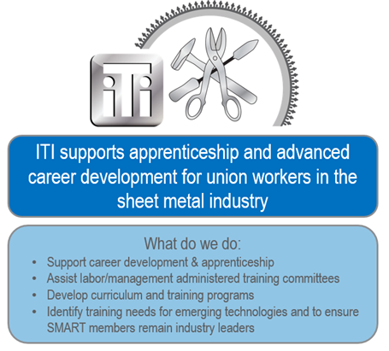
ITI Mission Statement

Slide 3
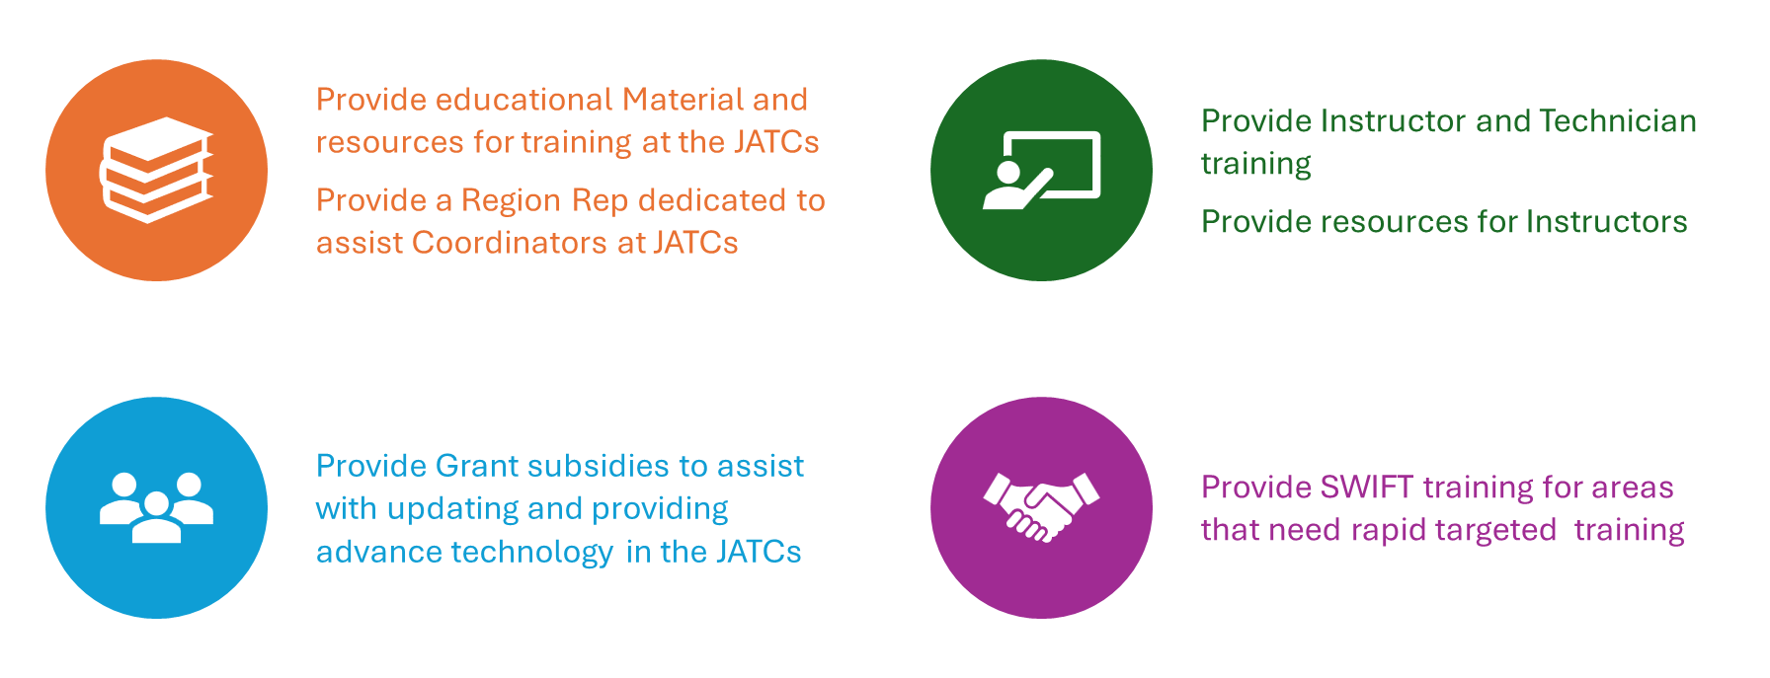

Slide 4
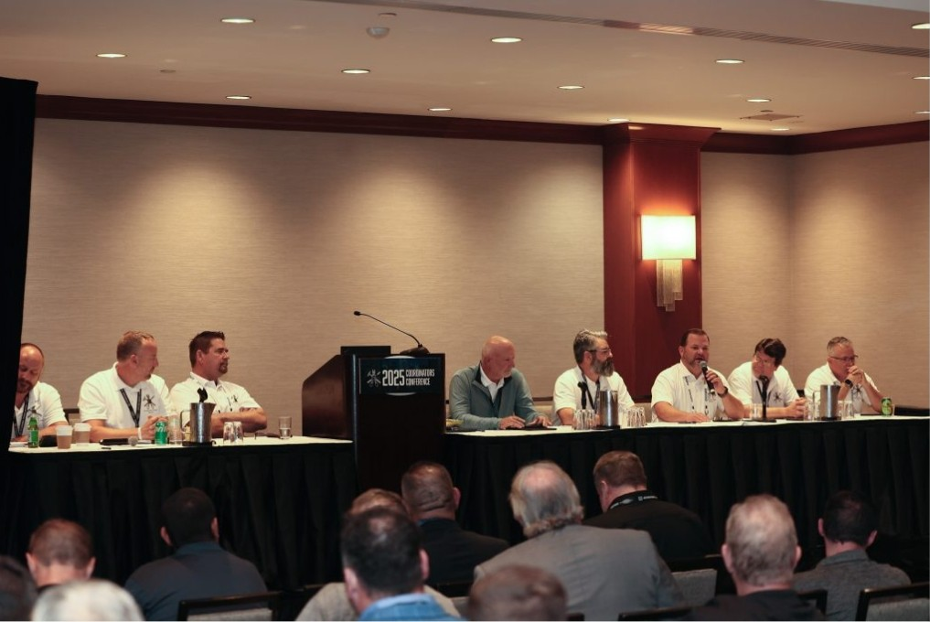
Coordinator Mentoring
Quarterly meetings
Networking
Updates from Region Reps

Slide 5
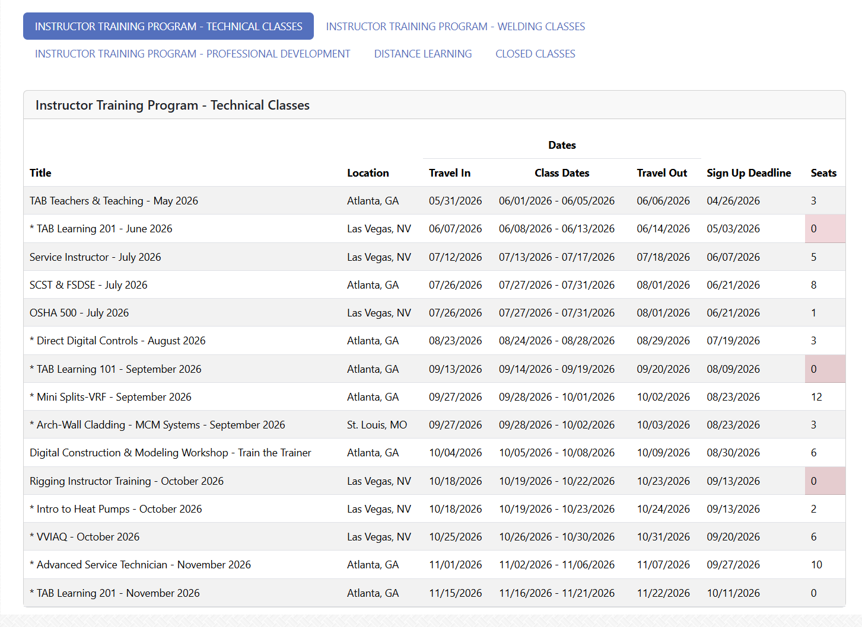
ITI Course Catalog
Instructor Training Program- Technical Classes ( in-person classes) *
*VVIAQ – Ventilation Verification Indoor Air Quality
*Architectural Wall- Cladding
*TAB Learning 101/201
*Basic/ Advance Service
*Intro to heat pumps
*Direct Digital Controls
*Mini Splits
Distance Learning- ( Online) *
*Revit for Sheet Metal Workers 100/ 200 series

Slide 6
Critical Environment Room Training
Topics for this course include:
An Introduction to Critical Environment Rooms
Cleanliness classification and requirements
Critical Environment Room Design Fundamentals
HVAC system design and airflow
Temperature & Humidity
Lighting & electrical requirements
Entry & exit procedures
Monitoring & maintenance
Validation & testing overview
Case studies and practical considerations
Critical Environment room inspection forms

Slide 7
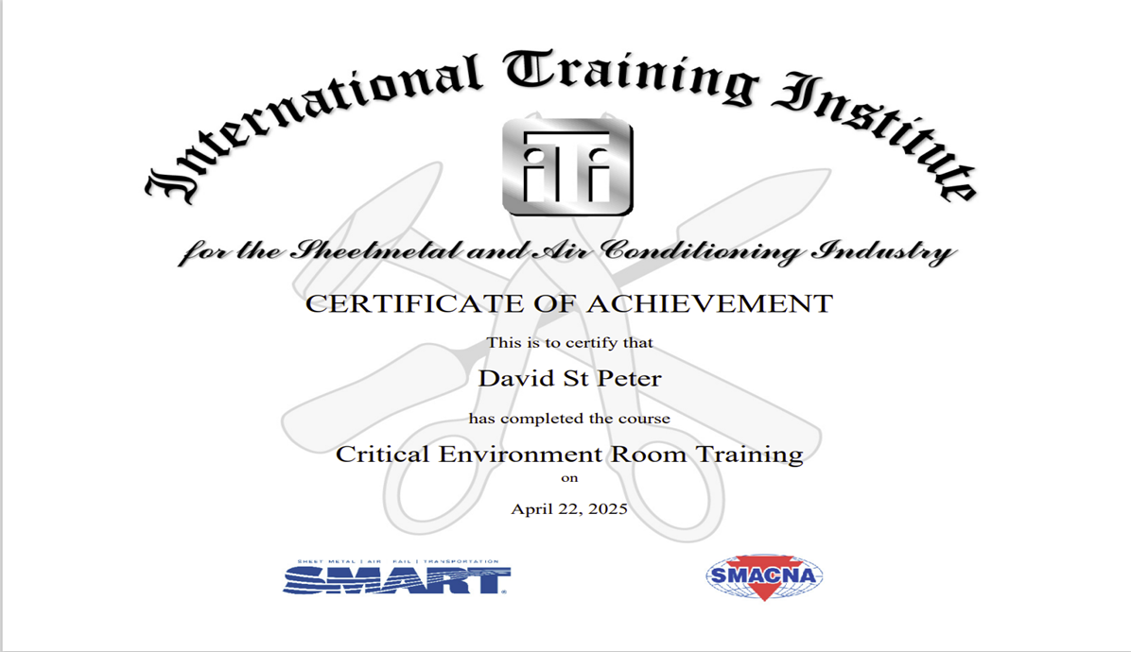
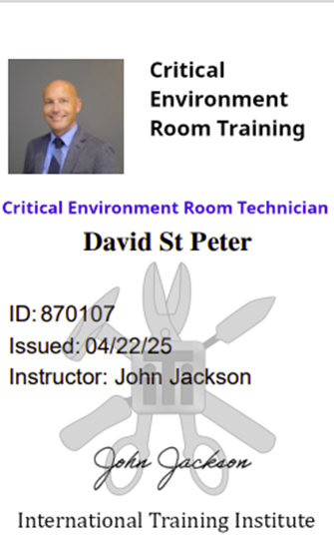

Slide 8
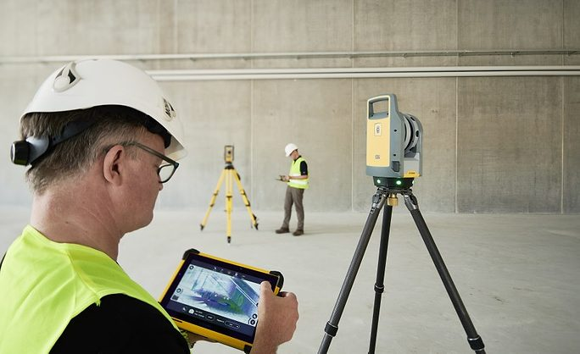
New and Updated Classes
Digital Construction and Modeling Workshop
Topics Covered:
  Trimble 3D Scanner Hardware and Setup
  Trimble Connect Software
  Point Cloud Registration and Processing
  EVOLVE Software Addon Application
  Productivity NOW Application
Dates: 10/04/2026 – 10/09/2026
Location: Atlanta, GA

Slide 9

  Foreperson Training: Train the Trainer
  Topics Covered:
Foreperson’s duties and responsibilities
Organizational, communication, and leadership skills
Document management, coordination, and technology
Productivity, cost control, scheduling, and safety
Promote inclusion, bias awareness, and effective team collaboration

Slide 10
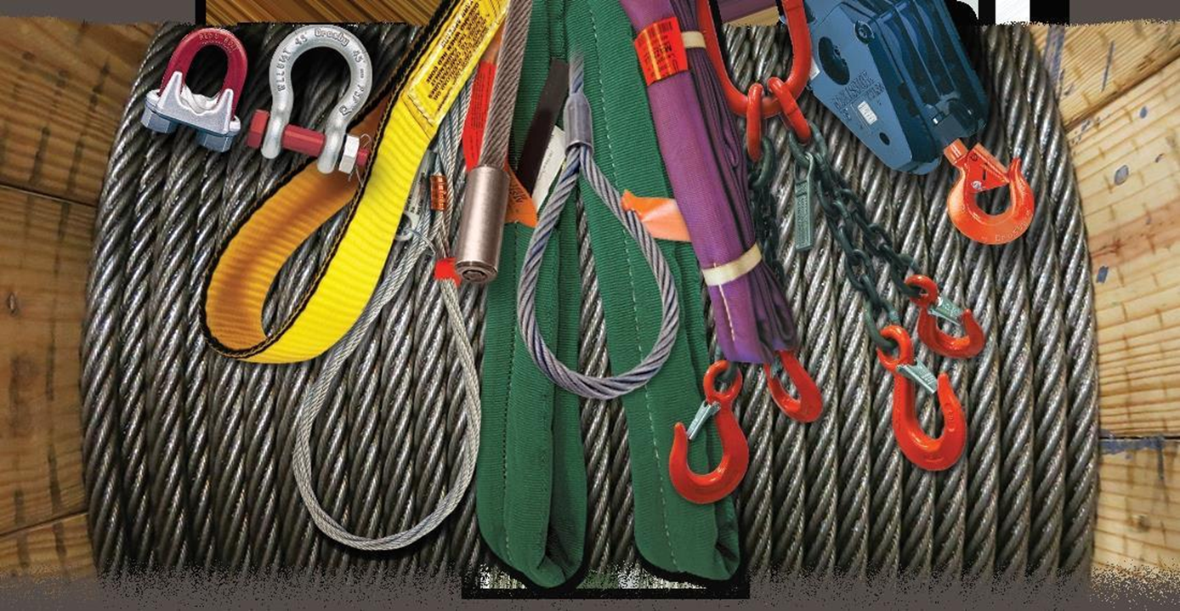
Rigging Instructor Training
Covered Topics:
ASME Standards and OSHA Regulations
Proper Rigging Techniques
Recognition, Inspection, and Use of Rigging Equipment and Slings
Calculations Involving Load Weight, Sling Angle, Tension, and Center of Gravity
Crane Operation Dynamics, Related Hazards, and ASME Hand Signals
Exam / Certification
​
​
Notes:
The it Rigging Instructor Training Course will provide a comprehensive Rigging & Signaling Trainer Development Class.
Upon completion of this class Instructors will be able to confidently teach an eight-to-twenty-four-hour rigging course in their home local
Exam: There will be an ICB Rigging & Signaling Certification Exam consisting of both written (CBT) and practical (hands-on) portions.
Certification: An ITI Completion Certificate will be issued to all participants. An ICB Rigging & Signaling Certification will be issued to all attendees who successfully complete both parts of the exam.

Slide 11

2027 and Beyond
WPQ1 (Welder Performance Qualified Endorsement) Exam
REVIT for Instructors
Stratus for instructors
Mobil TAB Lab
Notes:
WPQ1 (Welder Performance Qualified Endorsement) Exam
Per the AWS QC-47 Quality Assurance Manual it is required that a supplemental credential for AWS Certified Welding Inspectors (CWIs) is obtained as it demonstrates the inspector’s ability to conduct welder performance qualification tests in accordance with AWS standards

Slide 12

Accreditation
Out of 142 training centers, 132 Training Centers have been assessed and reviewed by the Accreditation Board
  87 Platinum
  22 Gold
  11 Silver
  10 Bronze
  2 are Revoked
  10 are Not Accredited

Slide 13
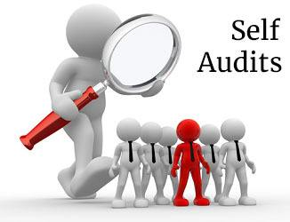
Self- Audits
8. On a separate page, provide the names and emails of Lead Trustee/s (sometimes referred as Co-chairs) and current trustees. Identify any new trustees. (Criteria 1.2)
9. On a separate page, provide the current annual full audit. This is for compliance with accreditation criteria 10.2. Criteria 10.2 reads "The JATC maintains proper monthly financial statements, and an annual audit, as required by Section 302(c) of the Labor Management Relations Act (LMRA)”. (Criteria 10.2)
Notes:
Although JATCs can be exempt from ERISA’s audit requirements, there are no exceptions to the LMRA’s. For this reason, regardless of size, JATCs must annually submit to a full, independent audit.

Slide 14
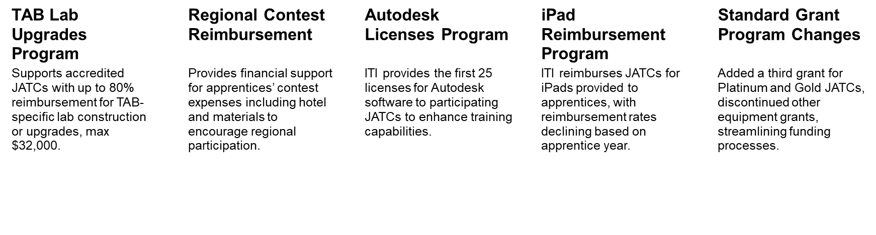
2026 Grant and Programs

Slide 15
Standard Grant
ACCREDITATION LEVEL | GRANTS AVAILABLE | REIMBURSEMENT LEVEL | MAXIMUM REIMBURSEMENT
PLATINUM | 3* | 80% | $32,000
GOLD | 3* | 60% | $24,000
SILVER** | 1 | 50% | $20,000
BRONZE** | 1 | 50% | $20,000

Slide 16
The National Guidelines for Apprenticeship Standards NGAS
Option 1: Hours- Based Hybrid
Structured primarily around on-the-job learning hours
6,400 – 7,200 OJL hours ( approximately 4-5 years)
Minimum 144 hours per year of related training
Wage progression based on time, typically every 6- 12 months

Slide 17
The National Guidelines for Apprenticeship Standards NGAS
Option 2: (New )Competency- Based Hybrid
Structured around competency attainment using a credit system
40 credits required for program completion
Minimum 2,000 OJL hours
Related training must be offered
Wage progression tied to credits earned, with no time‑based requirements

Slide 18
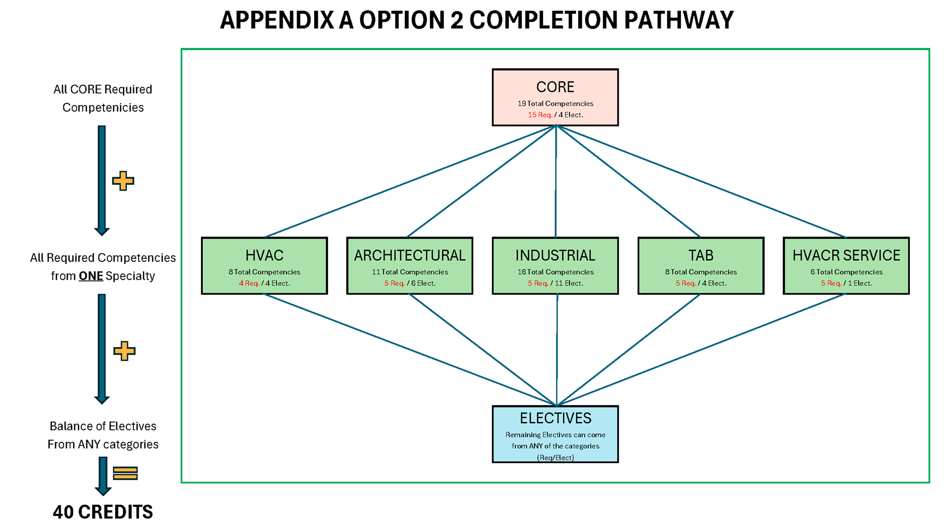

Slide 19
Implementation – Things to Consider
Develop Competency Tests and Sign off Forms (ITI Assist)
Logistics for Testing
Completely Restructure Training Program around Competencies, not “years”
Wage Progression must be added to CBA
Training of all Contractors and Key personnel
Formulate a Transition Plan
Modify Your Apprenticeship Standards (Educate SAA)

Slide 20
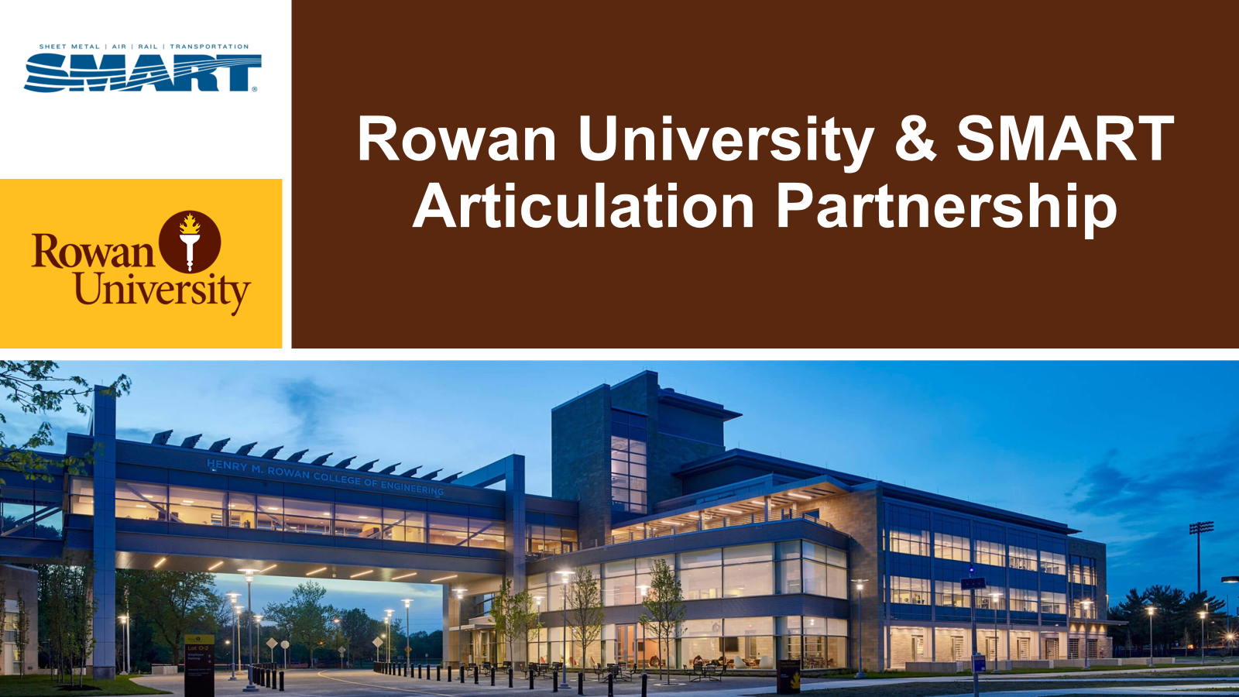
Notes:
For those of you unfamiliar with Rowan University, a few things I want to share about it that are relevant to the Trades: Rowan is a top-ranked public research institution with a long history of supporting economic development. As a public R2 research university with regional and national recognition, you’re not getting a generic degree — you’re getting one with serious credibility. Rowan is committed to advancing education in Construction Management through our partnership with North America’s Building Trades Unions.

Slide 21
Rowan University
Bachelor of Arts in Construction Management (BACM)
SMART members who have completed an apprenticeship are awarded 56 college credits.
Members holding OSHA 10 or 30 certifications receive an additional 3 credits.
This totals 59 credits, all of which are applicable exclusively to Rowan University.
Rowan University accepts free elective credits with a letter grade of "D" or higher from nationally accredited institutions and credit transfer organizations such as ACE and NCCRS.
A minimum of 30 credit hours must be completed through Rowan.
The program is delivered entirely online.
Notes:
Rowan University recognizes that union members have already put in the work — literally. Through partnerships with federally registered apprenticeship programs, Rowan offers a game-changing benefit:
For SMART members, you earn 56 college credits toward a Bachelor of Arts in Construction Management (BACM) just for completing your apprenticeship training. Covering nearly half of the 120-credit bachelor’s degree. with the 25% discount that's over 60% savings on total tuition costs.
BACM Degree: 120 credits
Published tuition Rates: Cost per credit: $588.63 ($70,635.60)
NABTU discount: 25% applied = $441.47 p/credit ($52,976.40)
Savings = $17,659.20
SMART apprenticeship articulation: 56 credits+ 3 credits for OSHA 10/30= 59 credits
SMART apprentice / member Costs: 61 credits to complete x $441.47 = $25,099.67
Total Savings off published rates: $70,635,60 - $25,099.67 = $43705.93 (62% savings)

Slide 22
Rowan University
Union members receive a 25% tuition discount
Published tuition Rates: Cost per credit: $588.63 ($70,635.60)
NABTU discount: 25% applied = $441.47 p/credit ($52,976.40)
  Savings = $17,659.20
SMART apprenticeship articulation: 56 credits + 3 credits for OSHA 10/30= 59 credits
SMART apprentice/member Costs: 61 credits to complete x $441.47 = $26,929.67
Total Savings off published rates: $70,635.60 - $26,929.67 = $43,705.93 (62% savings)
Notes:
Rowan University recognizes that union members have already put in the work — literally. Through partnerships with federally registered apprenticeship programs, Rowan offers a game-changing benefit:
For SMART members, you earn 56 college credits toward a Bachelor of Arts in Construction Management (BACM) just for completing your apprenticeship training. Covering nearly half of the 120-credit bachelor’s degree. with the 25% discount that's over 60% savings on total tuition costs.
BACM Degree: 120 credits
Published tuition Rates: Cost per credit: $588.63 ($70,635.60)
NABTU discount: 25% applied = $441.47 p/credit ($52,976.40)
Savings = $17,659.20
SMART apprenticeship articulation: 56 credits+ 3 credits for OSHA 10/30= 59 credits
SMART apprentice / member Costs: 61 credits to complete x $441.47 = $25,099.67
Total Savings off published rates: $70,635,60 - $25,099.67 = $43705.93 (62% savings)

Slide 23
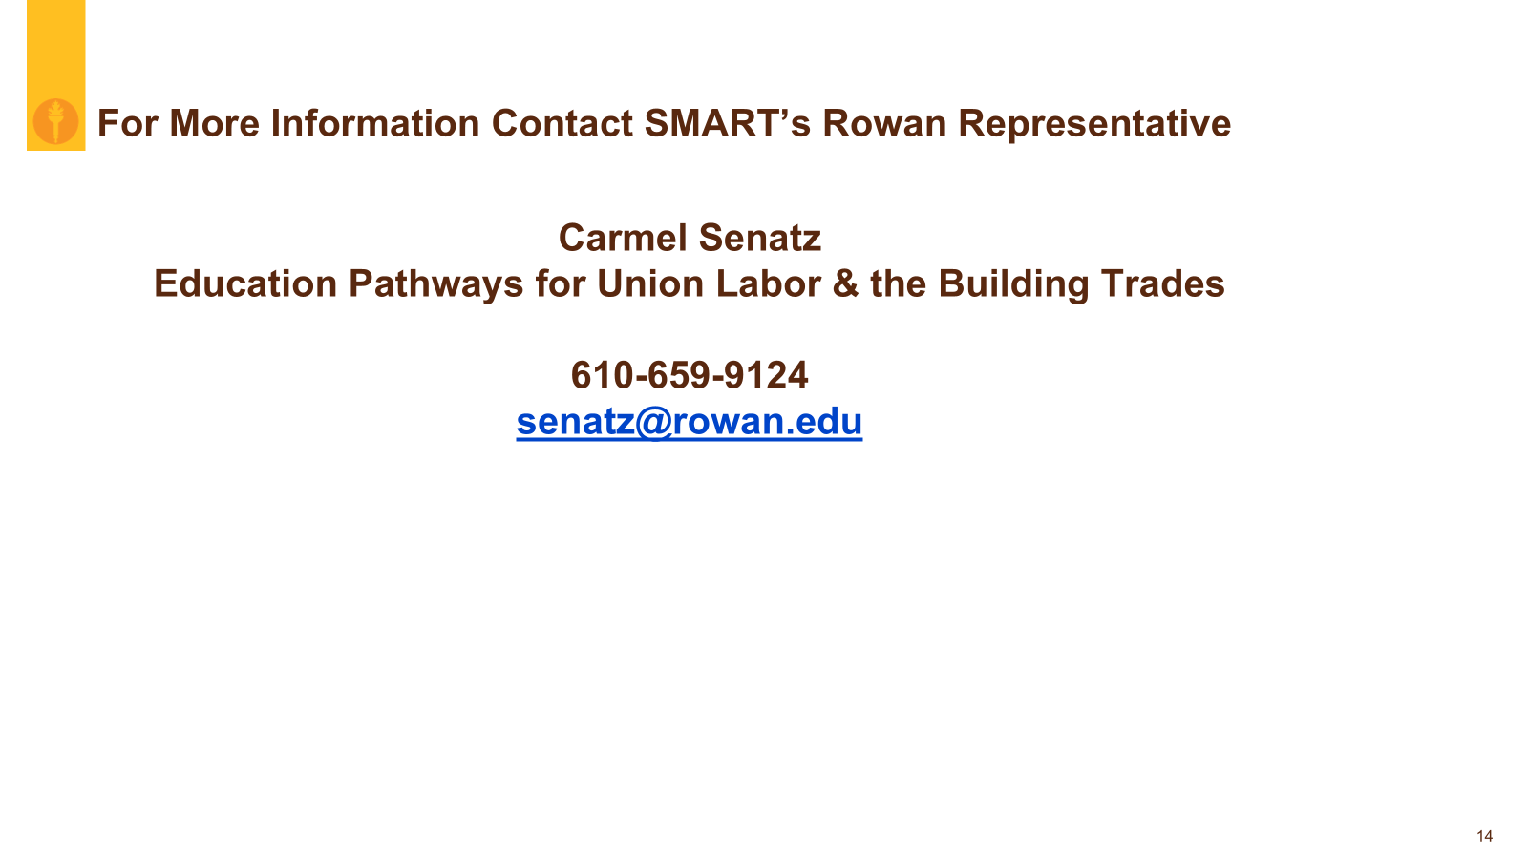
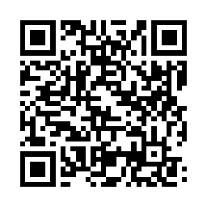
SMART Landing page

Slide 24
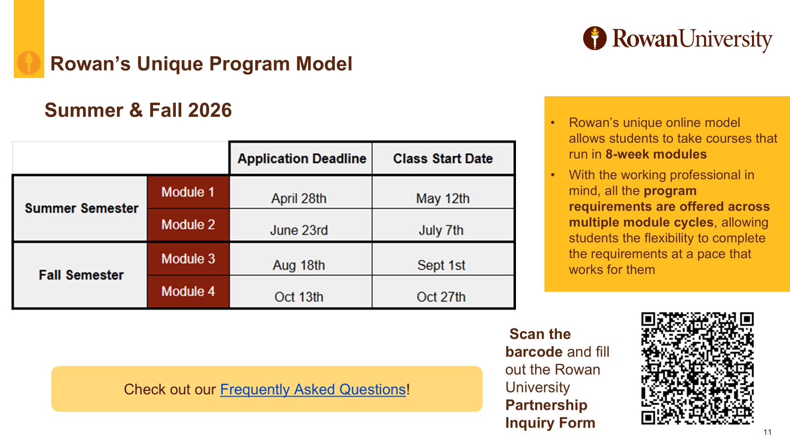
Notes:
Rowan offers class start dates six times throughout the year. One the slide are the two start dates for the Summer Semester and two start dates for Fall Semester. Rowan has a dedicated admissions team for union members.
To start the application process, you need to create a Rowan Account which you can do via the QR code. You will then receive login and a password. Once you login you can begin the application process.

Slide 25
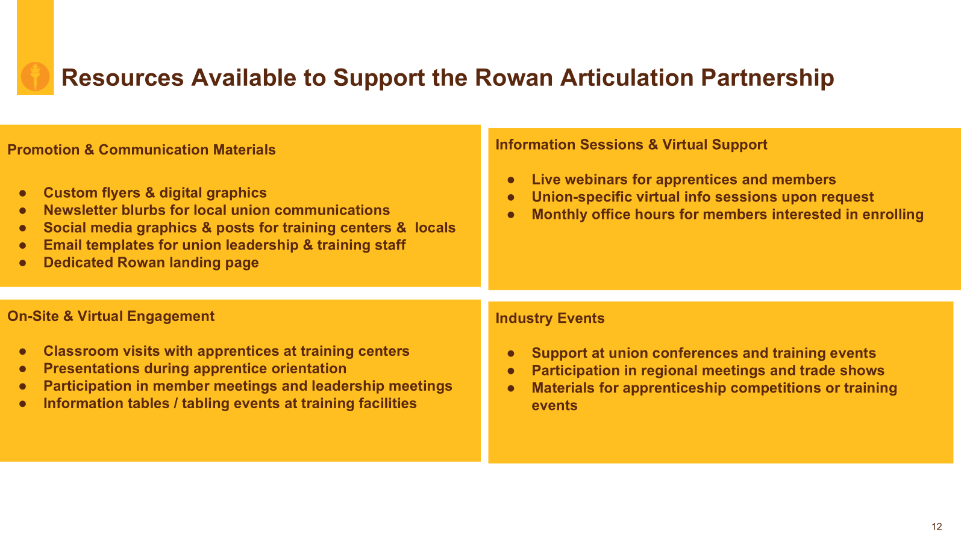

Slide 26
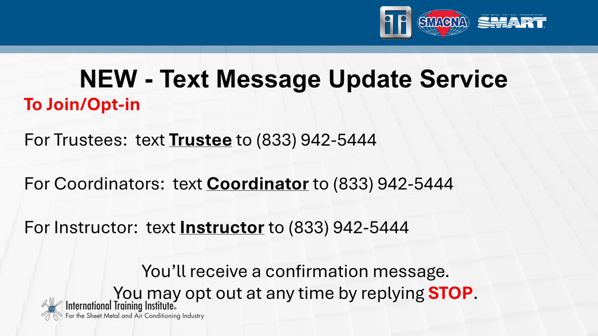

Slide 27
Bias and Belonging
Trainer Conference June 16-17
Falls Church, VA
Meet staff from across the industry (SMART, SMACNA, and the ITI) and build relationships
Share stories about how members have been positively impacted by the Bias and Belonging program
Collaborate to document lessons learned and improve best practices
Gain knowledge and skills that deepen your abilities as a trainer and facilitator
Share ideas for how we will move forward
Notes:
Train the Trainer since September of 2022 is 169
248 people have taken the online class for coordinators and instructors

Slide 28
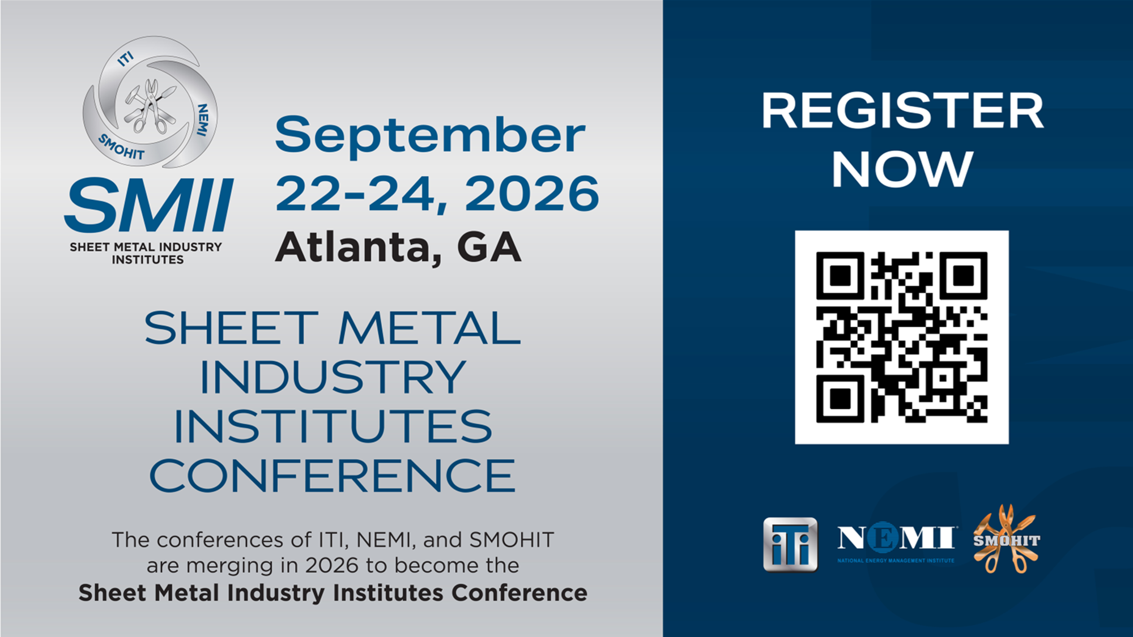

Slide 29

Any Questions

Slide 30


ITI Contacts
Administrator: John P Jackson
jjackson@sheetmetal-iti.org
201-835-5646
Program Administrator: Joseph J Potesta
jpotesta@sheetmetal-iti.org
317-373-6474

Slide 31


ERAC 2026
NEMI Update
MAKING
ENVIRONMENTS
SAFER
for people in schools, hospitals and commercial buildings nationwide.
Notes:
Good morning - on behalf of NEMI and our Fund Administrator, Craig Reehten, I’d like to thank you …… Council for the opportunity to provide a NEMI 2026 update.
Our mission remains simple but vital: to make environments safer, whether in schools, hospitals, or commercial buildings.
I will be sharing NEMI progress and developments on certifications, legislative wins, partnerships, and where we’re headed next.

Slide 32
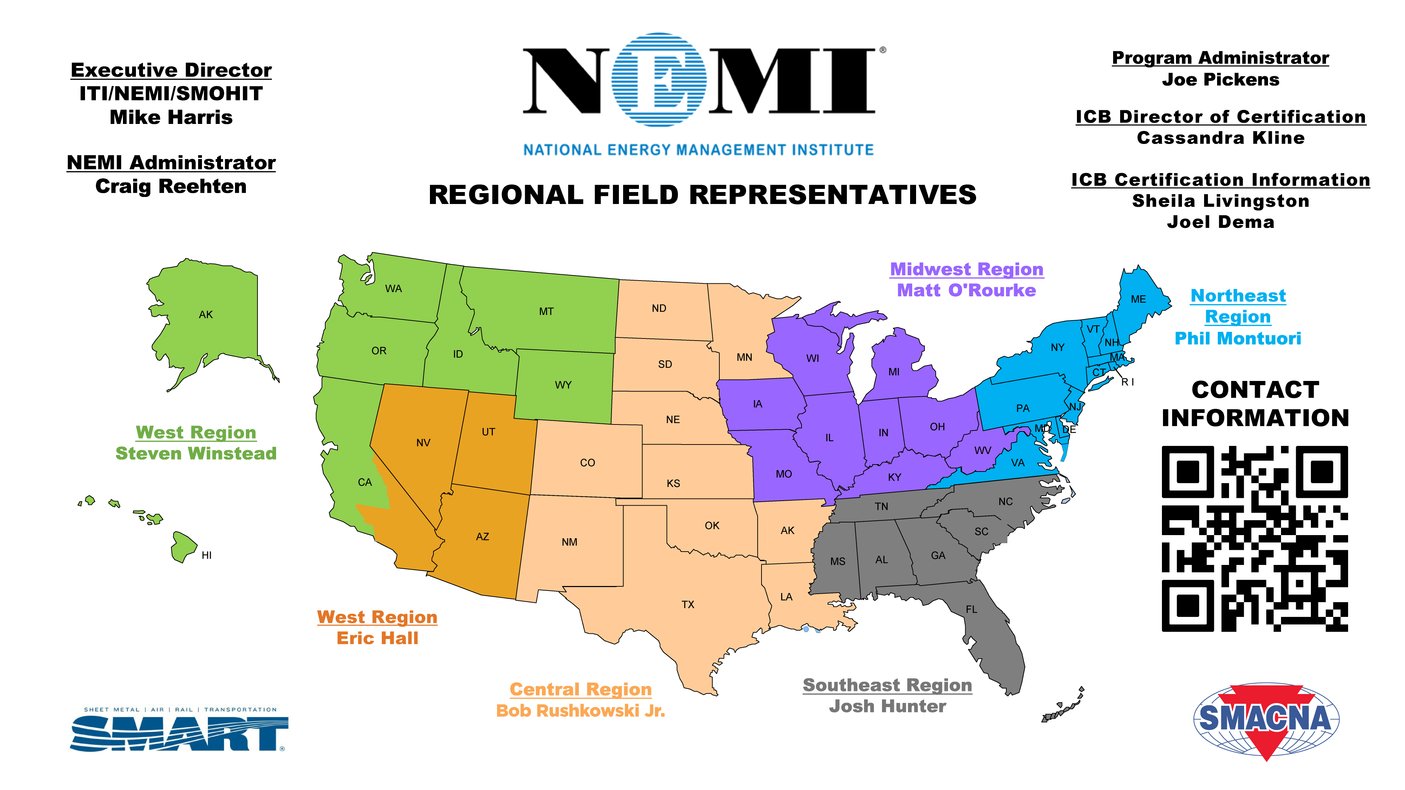
Notes:
New NEMI Staff:
Eric Hall (LU 206) Fall 2025 – Western Region Field Representative
Bob Rushkowski (LU 44) Winter 2025 – Central Region Field Representative

Slide 33
Mission Statement & SCOPE
National Energy Management Institute (NEMI) exists to make buildings safe and keep them healthy, while improving energy efficiency
WHAT WE DO:
Define Market Opportunities
Participate in Developing Codes and Standards
Develop Industry Recognized Certifications
Provide Resources to Support Implementation
Notes:
MISSION STATEMENT – WHAT WE DO – CONTIUSLY EVALUATING BETTER WAYS TO DO IT!
“Everything NEMI does falls into these four areas—and they all connect.”
“The key theme today: positioning a certified SMART workforce at the center of the industry.”
SCOPE:
Market Opportunities - outline current opportunities within our MISSION, outline how each is supported and implemented, identify potential expansion in new areas based on new technologies and emerging markets.
Codes/Standard - Outline which C/S we're involved in, identify responsibilities for each, delegate coverage, identify additional C/S within our scope.
Certs – Tracking of value, auditing performance, continuing development, supporting implementation strategies for each
While identifying new markets where a certification could potentially assist to support that market
Implementation - Identify implementation options that are available & strategic best practices with playbooks for each
Legislation, testimony, outreach/promotion, training (code officials-inspectors-responders-city/county/state officials)
“IN A NUTSHELL” - At NEMI we have the ICB… they have some certifications they offer… everything NEMI does is centered around supporting those certifications in some way, shape, or form

Slide 34
Why This Matters Now
Codes → Requirements
Legislation → Enforcement
Certification → Market Access
Standards → Code
Notes:
“This is no longer optional—this is how work is being defined.”
“If it’s in code, enforced by AHJs, and tied to certification—it becomes OUR work.”
In Nov. 2025 we started working on the 2028 NFPA 80 – It will be incorporated into the 2030 IFC – may not be adopted by states and local jurisdictions until years after that
In VA we’re currently using the 2021 IFC – its 2026 – we may not adopt the 2030 IFC until 2035 – that’s 10 years after the ref standard began it’s development

Slide 35
National Codes & Standards Update
NFPA 80 & 105: Inspection Standards Updates
  – Reinforcing Visual Inspections
ASHRAE: Leadership roles on multiple technical committees
IAPMO UMC 2027: ISO 17024, SMACNA Standards
ICC 2028: Proposed inclusion of SMACNA TAB Manual
Notes:
NEMI influencing ventilation, IAQ, TAB, fire life safety
Early involvement = control over direction
“We’re not reacting to codes—we’re helping write them.”

Slide 36
Outreach & Partnerships
Nationwide AHJ Engagement & Training
Implementation Advisory Groups (local action model)
Industry Partners: Evergreen Telemetry, Testo (discounted equipment)
Notes:
Our outreach continues to expand. We’re partnering with AHJs nationwide, offering training and resources. We’ve created Implementation Advisory Groups as a framework for local action. And our industry partnerships with Evergreen and Testo are delivering discounted instrumentation to certified contractors, strengthening workforce readiness.

Slide 37
VA
NJ
WA & WI
Virginia HB 2618 – School IAQ inspections (July 2025)
Legislative
Wins
New Jersey – Fire/Smoke Damper
enforcement clarified
Washington & Wisconsin – Fire/Smoke Damper legislation passed
Notes:
We’ve saw real policy wins in 2025. Virginia passed legislation requiring all schools to undergo regular indoor air quality inspections. New Jersey clarified enforcement of its fire and smoke damper law. And in Washington and Wisconsin, new laws are already in place, with training and implementation underway,
Working with TD partners.

Slide 38
Legislative Efforts
Arizona FLS
Georgia & Florida – AHJ training and TAB/IAQ recognition
Kansas & Missouri – FLS Certification-focused legislation drafted
Early Initiatives: Kentucky, Massachusetts, Tennessee
Rhode Island – IAQ – Passed Senate Committee (March)
Michigan – IAQ – Early Stages – Sponsor in House
Notes:
Beyond those wins, we’re laying groundwork across the country. Kentucky, Massachusetts, and Tennessee are moving forward with early-stage efforts. Georgia and Florida are focused on AHJ training and code recognition. Kansas and Missouri have legislation drafted, emphasizing certification requirements.
Speak to our playbook and strategic approach building Advisory Committee Groups.
MI IAQ bill has sponsor in House – Feb/Mar 2026 - MI Legislative Resources making final reviews before heading to committee
RI IAQ bill has passed committee and is waiting to be heard on the floor (Senate)

Slide 39

Why Certifications Should Matter
Today’s industry expects verifiable, portable credentials
ICB certifications:
  Validate competency
  Support safety and quality
  Strengthen the value of apprenticeship completion
JATCs are no longer evaluated only on training hours

Slide 40
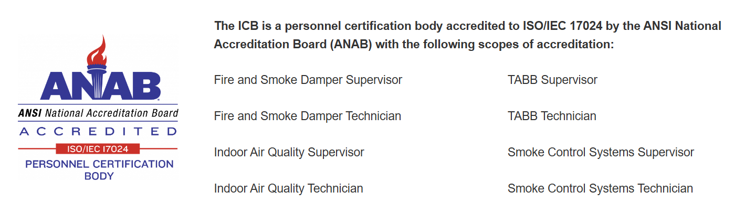
The Role of ICB in Credentialing
ICB (International Certification Board):
  Independent, third-party certification body
  Accredited to ISO/IEC 17024 (ANAB)
Certifications are:
  Developed by industry SMEs
  Based on Job Task Analyses
  Maintained through continuing education and renewal

Slide 41
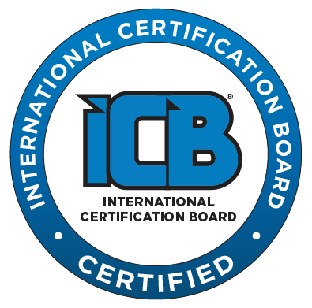
TABB LABS APPROVED TO-DATE
Local 104 – Fairfield
Local 66 – Everett
Local 88 – Las Vegas
Local 36 – St. Louis
Local 105 – SoCal
Local 10 – Metro, (Minneapolis, MN)
Local 19 Central – Hamburg, PA
Local 85 – Atlanta
Local 73 – Chicago
Local 80 – Detroit
Local 49 – Albuquerque
Local 27 – Farmingdale, NJ
Local 359 – Phoenix (Next Week)
Notes:
Local 85 - 29 New TABB Technicians in just that Training center since October. = almost 3% of all TABB techs

Slide 42
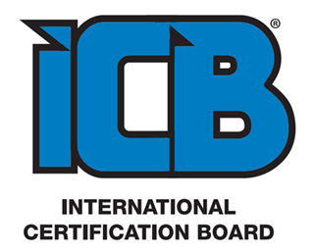
International Certification Board
Rigging and Signaling Professional **BETA**
Scope of Certification
The Rigging and Signaling Professional is responsible for possessing the knowledge, skills, and competencies required to perform rigging and signaling tasks safely and correctly in industrial and construction environments. This certification is designed for professionals responsible for the planning, execution, and supervision of rigging and signaling operations, ensuring compliance with industry standards and safety regulations.

Slide 43
International Certification Board
Rigging and Signaling Professional **BETA**
Certification Overview
Safe Rigging Practices
Load Weight, Sling Angle, Tension and Capacity
Load Control
Identiﬁcation, Inspection and Application of Rigging Hardware and Slings
Rigging Plan Development
Lever and Chain Hoists Identification, Application and Inspection
Crane dynamics, Operation Limitations and Associated Hazards
Requirements for below the hook lifting devices
ASME Hand Signals

Slide 44
NEMI Supervisor Training Program Timeline
2026 Rollout
Regional event model with training, lab, and exam in a 4-day format.
West Region Training
July 13th – 16th, 2026
East Region Training
August 3rd – 6th, 2026
Central Region Training
October 12th – 15th, 2026

Slide 45

Data Centers: IA Coordination & Strategy
IA Mega Project Team
IA Government Affairs
NEMI technical leadership
Focus:
  Cooling systems & infrastructure
  Energy & water policy
Promoting:
  Air-side economizers
  Hybrid cooling systems
  Low-water designs
Notes:
“This is a coordinated effort across the International.”
Influencing cooling system design and policy
Driving designs that create sheet metal + TAB work
“We’re not waiting for the market—we’re helping shape it.”
Liquid cooling is still the dominant direction of travel
AI workloads are pushing rack densities from ~15 kW → 80–120+ kW, which air simply struggles to handle
Liquid cooling can handle 200 kW+ per rack, vs air hitting limits around ~40 kW
Industry forecasts show liquid-cooled servers jumping to ~76% by 2026
Massive capital is flowing into liquid (e.g., Ecolab acquiring CoolIT to capture this growth)
👉 Net: For hyperscale + AI = liquid is becoming standard, not optional.
2) But… air cooling is absolutely NOT going away
Air is still:
Cheaper upfront
Easier to operate/maintain
Lower perceived risk (leaks, complexity)
It still works well for:
Lower-density workloads
Enterprise / colocation / legacy environments
👉 Net: Air remains the default for “normal” data centers.
3) The real answer: hybridization
This is where things get interesting (and probably explains what you're hearing):
Many experts expect hybrid designs (air + liquid) to dominate
Even in AI builds:
Liquid at the chip/rack level
Air at the room level (heat rejection, CRAH/CRAC, etc.)
👉 The industry isn’t flipping from one to the other—it’s layering systems.

Slide 46
Data Centers: What This Means for Locals
Major long-term market opportunity
Certified workforce advantage:
TAB & commissioning
Air systems & fabrication
Supporting Locals:
Unified talking points in development
Webinars coming soon
Labor priorities:
Local hiring
Apprenticeship utilization
Prevailing wage
Notes:
“This only matters if Locals are positioned to take advantage of it.”
IA + NEMI developing tools and messaging
Webinars will support rollout
“We’re giving Locals the tools to go after this work.”

Slide 47
Looking Ahead
Expand Labs & Certification Capacity
Grow IAQ & Fire/Life Safety Legislation
Strengthen Role in ASHRAE, NFPA, ICC, IAPMO
Position Locals Market Opportunities
Notes:
As we look forward, our priorities are clear: expanding lab access, pushing for more IAQ and fire/life safety legislation, and maintaining a strong presence in standards organizations. Just as important, we need to position Locals to take advantage of funding and code enforcement opportunities that will continue to emerge.

Slide 48

Call to Action
Union Leadership and Training = Key to Advancing NEMI and ICB’s Mission
Engage with Legislators, AHJs, and Contractors
Resources: NEMIONLINE.org | ICBCERTIFIED.org
Notes:
In closing, councils are critical to advancing NEMI’s mission. We rely on your leadership to engage with legislators, AHJs, and contractors in your regions. Together, we can expand certification, influence policy, and strengthen our workforce. Thank you for your time and commitment — I’m happy to take any questions
The coordination that’s taken place in the SE this past year between the Locals and the Funds has been remarkable. From the TABB efforts in 4, 5, 177 to the coordination of the FL
Advance to Contacts

Slide 49
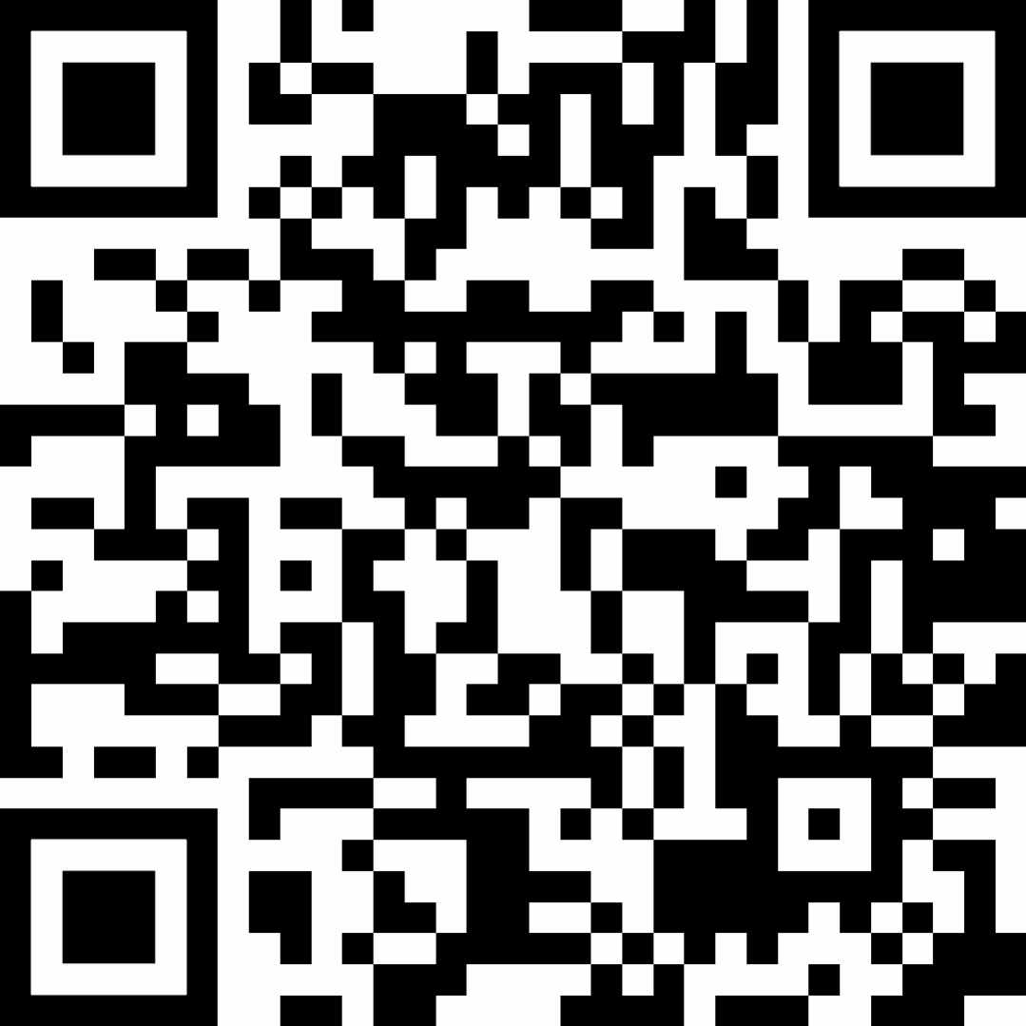
Craig Reehten
NEMI Administrator
CReehten@nemionline.org
Mike Harris
Executive Director
MHarris@sheetmetal-iti.org
National Energy Management Institute
ON SOCIAL
Program Administrator
jpickens@nemionline.org
(540) 394-0152

