Slide 1
Policies and Your Joint Apprenticeship and Training Committee (“JATC”)
Mark E. Belland, Esquire
Shareholder
O’Brien, Belland & Bushinsky, LLC
Moorestown, NJ

Slide 2
Overview
Core governance policies for training centers
Compliance with labor and employment laws through Equal Opportunity, and anti-harassment policies
Safety and workplace conduct standards
Technology, social media, and confidentiality considerations
Best practices for drafting, updating, and enforcing policies
Key Takeaways

Slide 3
Why Policies are Critical
Risk Management
  Reduce fraud, mismanagement, and legal liability
Compliance
  Align with state, federal, and local requirements, grant conditions, and fiduciary duties
  Demonstrate good governance to regulators and contributing employers

Slide 4
Why Policies are Critical
Operational Integrity
  Prevent arbitrary decision-making
  Ensure fairness, consistency, and accountability
Reputation Protection
  Builds trust with apprentices, journeypersons, unions, employers, and funders

Slide 5
Who is responsible?
Board of Trustees
  Ultimate fiduciary responsibility
  Approve policies, oversee compliance, and enforce accountability
Administrator or Director of Training
  Implement policies in daily operations
  Ensure staff adherence and proper documentation
  Oversight of financial controls, budgets, and expenditures

Slide 6
Who is responsible?
Instructors
  Enforce policies at the operational level
  Identify and escalate compliance issues
Legal Counsel
  Draft/review policies for legal sufficiency and risk mitigation
Other Professionals
  Provide specialized expertise (e.g. accounting, IT) to support compliance, risk management, and policy integrity

Slide 7
What are Core Governance Policies?
Definition and Scope
  Formal rules that define how the training center is managed, controlled, and held accountable
  Establish decision-making authority, financial oversight, and operational standards
  Apply to boards, trustees, administrators, and key staff
Key Functions
  Create consistency and transparency in operations
  Define roles, authority, and limits
  Provide a framework for legal and regulatory compliance

Slide 8
Types of Core Governance Policies
Foundational Governance Documents
  Bylaws
  Trust Agreements
    Fiduciary Authority
    Authority to Delegate
  Conflict of Interest Policy

Slide 9
Types of Core Governance Policies –
Financial Oversight and Internal Controls
Financial Oversight and Internal Controls
  Expenditure and Disbursement Policy
  Travel and Business Expense Policy
  Credit Card Policy
  Procurement and Purchasing Policy
  Audit Policy
  Delinquent Contributions Policy
  Compensation Policy
  Vehicle Use Policy
  Investment Policy

Slide 10
Types of Core Governance Policies –
Financial Oversight and Internal Controls
Expenditure and Disbursement Policy
  Establishes approval requirements and controls for all outgoing funds
  Ensures proper documentation and prevents unauthorized or improper payments
Travel and Business Expense Policy
  Defines allowable expenses, reimbursement standards, and required documentation
  Prevents misuse of funds and ensures consistency in expense approvals

Slide 11
Types of Core Governance Policies –
Financial Oversight and Internal Controls
Credit Card Policy
  Limits who may use organizational credit cards and for what purposes
  Requires receipts, timely reconciliation, and prohibits personal use
Procurement and Purchasing Policy
  Establishes procedures for vendor selection, bidding, and contract approval
  Promotes transparency, cost control, and avoidance of conflicts of interest

Slide 12
Types of Core Governance Policies –
Financial Oversight and Internal Controls
Audit Policy
  Ensures accuracy of financial reporting and identifies control weaknesses
Delinquent Contributions Policy
  Defines procedures for tracking and collecting late employer contributions
  Establishes enforcement mechanisms and protects fund integrity

Slide 13
Types of Core Governance Policies –
Financial Oversight and Internal Controls
Compensation Policy
  Establishes guidelines for setting and reviewing staff compensation
Vehicle Use Policy
  Defines authorized use of organizational vehicles and safety requirements
Investment Policy
  Protects invested funds through prudent oversight, diversification, and compliance with trust requirements

Slide 14
Types of Core Governance Policies – Administrative and Operational Guidance
Administrative and Operational Guidance
  Record Retention Policy
  Meeting and Minutes Policy
  Contract Approval Policy
  Cybersecurity and Confidentiality Policy

Slide 15
Types of Core Governance Policies – Administrative and Operational Guidance
Record Retention Policy
  Defines how long records must be maintained and in what format (physical/electronic)
  Ensures compliance with legal requirements and supports audits and investigations
Meeting and Minutes Policy
  Requires formal documentation of board and committee meetings, including decisions and actions

Slide 16
Types of Core Governance Policies – Administrative and Operational Guidance
Contract Approval Policy
  Specifies who has authority to review, approve, and execute contracts
  Ensures legal review and prevents unauthorized or high-risk agreements
Cybersecurity and Confidentiality Policy
  Protects sensitive apprentice, employee, and organizational information
  Restricts access and prohibits unauthorized use or disclosure of data

Slide 17
Compliance with Labor and Employment Laws Through EEO and Anti-Harassment Policies
Equal Employment Opportunity (“EEO”) Policy
  Prohibit discrimination based on protected characteristics
  Required for compliance with federal and state civil rights laws and apprentice regulations
Anti-Harassment and Anti-Retaliation Policy
  Defines prohibited conduct (e.g. sexual harassment)
  Establishing reporting channels and investigation procedures
Apprentice Selection and Recruitment Policy
  Governs faire and compliant selection procedures
  Aligns with DOL apprenticeship standards

Slide 18
Compliance with Labor and Employment Laws Through EEO and Anti-Harassment Policies
Attendance and Leave of Absence Policy
  Covers sick leave, personal leave, and legally required leave (e.g. FMLA where applicable)
Reasonable Accommodation Policy
  Addresses obligations under disability laws
  Covers accommodations for religion, disability, and pregnancy

Slide 19
Types of Safety and Workplace Conduct Policies
Workplace Safety and OSHA Compliance Policy
  Establishes safety standards and reporting requirements that aligns with OSHA regulations
Drug and Alcohol Policy
  Prohibits impairments in safety-sensitive environments
  May include testing protocols and disciplinary measures

Slide 20
Types of Safety and Workplace Conduct Policies
Progressive Discipline Policy
  Defines steps for addressing rule violations
  Ensures consistency and reduces wrongful termination risk
Grievance and Complaint Resolution Policy
  Provides a structured process for apprentices and staff to raise concerns

Slide 21
Technology and Confidentiality Issues
Unique Risk Profile
  JATCs handle sensitive apprentice data, employer information, and union-related records
  Data breaches and unauthorized disclosure
  Reputational harm via social media
  Misuse of training systems and employer resources
Regulatory and Legal Exposure
  Privacy laws, recordkeeping obligations, and contractual confidentiality requirements

Slide 22
Technology and Confidentiality Standards
Key Controls
  Password protection and secure access protocols
  Restrictions on downloading, sharing, or storing sensitive data
  Monitoring of systems to ensure compliance
High-Risk Areas
  Personal device use (“BYOD”)
  Unauthorized software or cloud storage platforms

Slide 23
Confidentiality and Data Protection
What Must Be Protected
  Apprentice records (performance, discipline, personal data)
  Contractor information
  Financial and administrative records

Slide 24
Confidentiality and Data Protection
Core Requirements
  Limit access to need-to-know basis
  Secure storage (digital and physical)
  Prohibit unauthorized sharing both internally or externally
Consequences of Failure
  Legal liability, audit findings, and loss of trust
  Potential contractual or regulatory violations

Slide 25
Types of Technology, Social Media, and Confidentiality Policies
Acceptable Use of Technology Policy
  Limits use of JATC systems to authorized training and business purposes
  Prohibits misuse, unauthorized access, and inappropriate content
Electronic Communications Policy
  Governs use of electronic platforms
  Clarifies monitoring rights and prohibits unprofessional or unlawful communications

Slide 26
Types of Technology, Social Media, and Confidentiality Policies
Data Privacy and Confidentiality Policy
  Protects apprentice records, personnel data, and sensitive organizational information
Remote Access and Network Security Policy
  Establishes rules for accessing systems off-site or on personal networks
Social Media and Online Conduct Policy
  Prohibits harassment, discrimination, and disclosure of confidential information online

Slide 27
Types of Technology, Social Media, and Confidentiality Policies
Data Retention and Destruction Policy
  Defines how long records must be kept and when they must be destroyed
  Requires secure disposal of both physical and electronic records
Incident Response and Data Breach Policy
  Establishes procedures for identifying, reporting, and responding to breaches
  Assigns responsibility for investigation, mitigation, and required notifications

Slide 28
Best Practices for Drafting Policies
Involve legal counsel in all steps
Use clear, unambiguous language
Define scope, applicability, and key terms
Delegate authority to act, approve, and enforce
Include step-by-step procedures where consistency is critical
Ensure policies align with applicable laws, apprenticeship standards, and CBA obligations

Slide 29
Best Practices for Updating Policies
Conduct formal reviews on periodic basis
Assign clear responsibility for monitoring legal and regulatory developments
Revise policies after incidents, audits, or identified compliance gaps
Update in response to evolving areas (e.g. technology use, marijuana laws)
Redistribute updated policies and require acknowledgment from staff and participants

Slide 30
Example of Legal Changes on Policies
State marijuana laws continue to expand in conflict with federal law
  Medicinal
  Recreational
Changes may require a shift from “zero tolerance” to impairment based standards
Marijuana testing is continuing to evolve with the law and policies need to keep pace

Slide 31
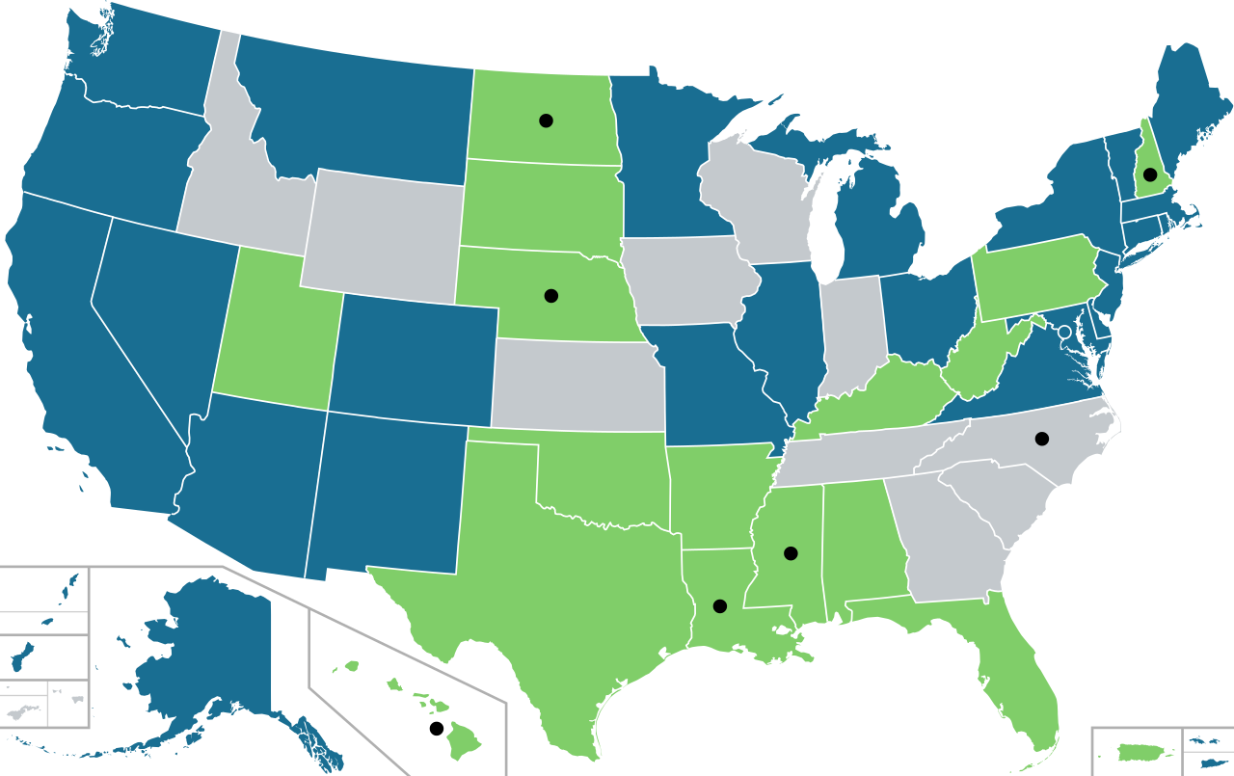
Example of Legal Changes on Policies

Slide 32
Best Practices for Enforcing Policies
Apply policies uniformly across all individuals
Train supervisors and instructors on how to apply policies in real scenarios
Ensure employees and apprentices understand expectations and consequences
Document violations, investigations, and disciplinary actions thoroughly
Enforce consequences as written as failure to act undermines the policy’s validity

Slide 33
Consequences of Weak or Missing Policies
Legal & Financial Exposure
  Increased risk of fraud, embezzlement, and misuse of funds
  Liability for breach of fiduciary duty
Regulatory Consequences
  Failed audits
  Loss of funding, grants, or accreditation
  Government enforcement actions

Slide 34
Consequences of Weak or Missing Policies
Operational Breakdown
  Inconsistent decision-making
  Internal disputes and lack of accountability
Litigation Risk
  Harder to defend employment or financial decisions
  Lack of policies creates perception of negligence

Slide 35
Suggested Financial Policies
All JATCs should consider implementing the following financial policies to ensure sufficient safeguards:
  Expenditure Policy
  Credit Card Policy
  Travel Policy
  Business Expense Policy
  Investment Policy Statement

Slide 36
Key Takeaways
Sound policies leads to strong, sustainable training programs
Stay proactive and compliant
Regular reviews of policies ensure accountability and future readiness
Legal compliance is not just a duty—it’s protection for your mission

