Slide 1
SMOHIT Update
Aldo Zambetti
Administrator

Slide 2
SMOHIT Staff
  Aldo Zambetti – Administrator
  Jeff Bradley – Program Administrator
  Ed Robison – Field Representative
  Lisa Davis – Field Representative
  Kalima Ramsey - Walker – Field Representative
  Jeremy Holburn – Field Representative
  SMOHIT works closely with Chris Carlough – Director of Wellness and Mental Health Support.

Slide 3
SMOHIT Trustees
  Danny Villarruel – Co-chair
  Matt Hildreth – Co-chair
  Jon Alvino – New trustee 2025
  Wayne Greenwood – New trustee 2025

Slide 4
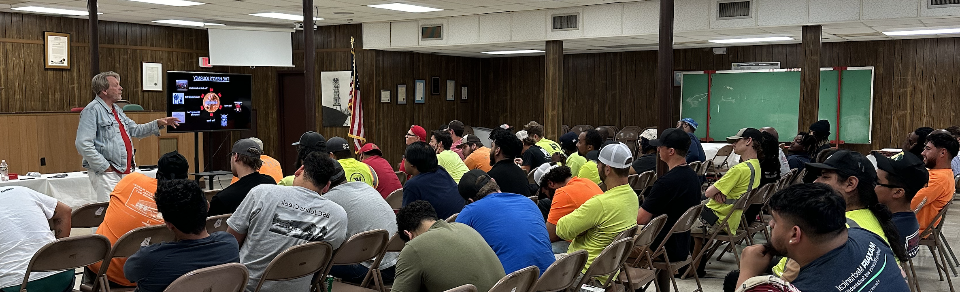
SMART MAP
Peer-to-Peer
Mental Health Awareness
SMART MAP Mental Health Trainings
Notes:
SMART MAP 3-day national mentor training. Currently we schedule three sessions per year in different locations. Open to all SMART members and SMACNA contractors. Usually attended by Coordinators, Instructors, Business Managers, Agents, and Organizers.
Peer to Peer- 2-day Local training that we bring to you to get the information to local leaders, superintendents, forepersons, office staff, etc.
Mental Health Awareness –8 hour customizable mental health overview
Who should attend: Our trainings are for anyone who wants to make a difference in their local union and community. Participants leave the session with the skills they need to assist members in crisis. SMART MAP doesn’t teach you to be a counselor, but participants learn how to listen and what to do with the information they hear. Sometimes that means bringing in professionals. Other times, it’s just to listen. Mental health is just as much a part of jobsite safety as PPE, and our trainings illustrate that.

Slide 5
Core topics covered during the sessions are
  Mental health
  Substance use disorder
  Suicide prevention awareness
  Resources
  Peer support
Facilitators often speak from personal experiences, and attendees can do the same in a safe environment.
Notes:
We get a lot of feedback on our surveys of how much our members appreciate the personal experiences that our speakers relay in the training. It makes the subject matter relatable.

Slide 6
Other topics may include:
  Addiction: The Disease Model
  Relapse Sequence
  Stages of Change and Motivational Interviewing
  Confidentiality and Ethics for Peer Representatives
  Communication
  Legal Issues
  Weed Inc.: The Colorado Experiment
  Navigation of the Health Insurance/Treatment Center World
  Aftercare Programs
  Narcan Administration

Slide 7


Upcoming SMART MAP Sessions
Charleston SC, February 2027
Notes:
Upcoming sessions are in Denver and San Diego. To register for the next SMART MAP session, go to smohit.org, and SMART MAP will be highlighted on the home page. You must have an account on the SMOHIT website to register for any class.

Slide 8
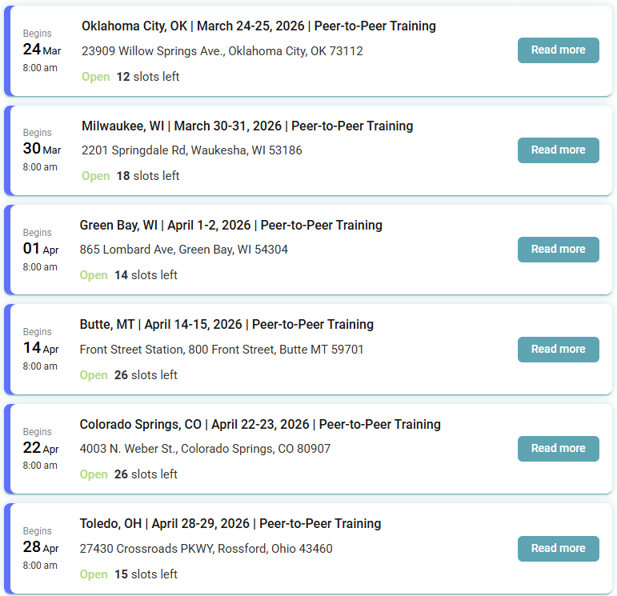
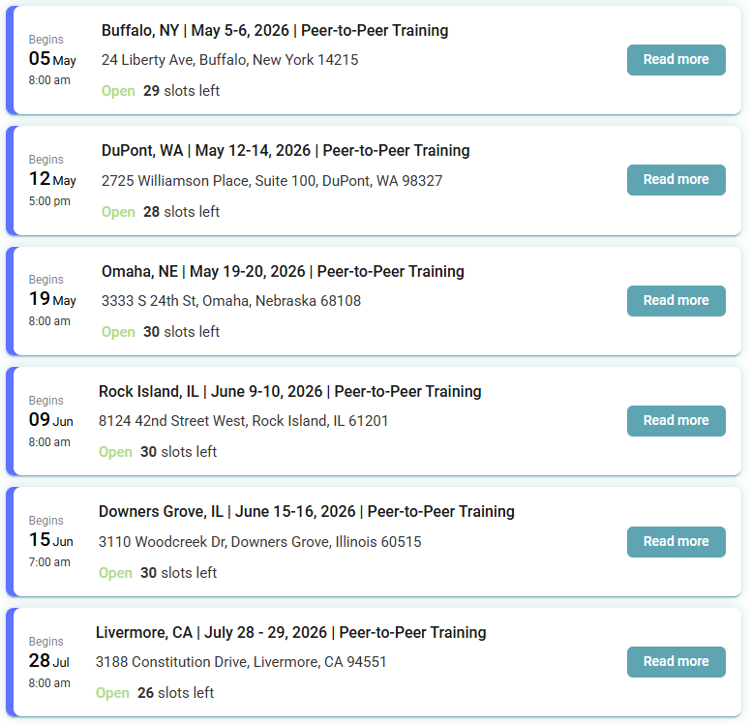
Upcoming Peer-to-Peer Sessions
Notes:
If you would like us to come to your local area, please visit smohit.org > Events > Upcoming Classes> and scroll to the bottom of the page to send a request.
Wd can be scheduled up to a year out.

Slide 9
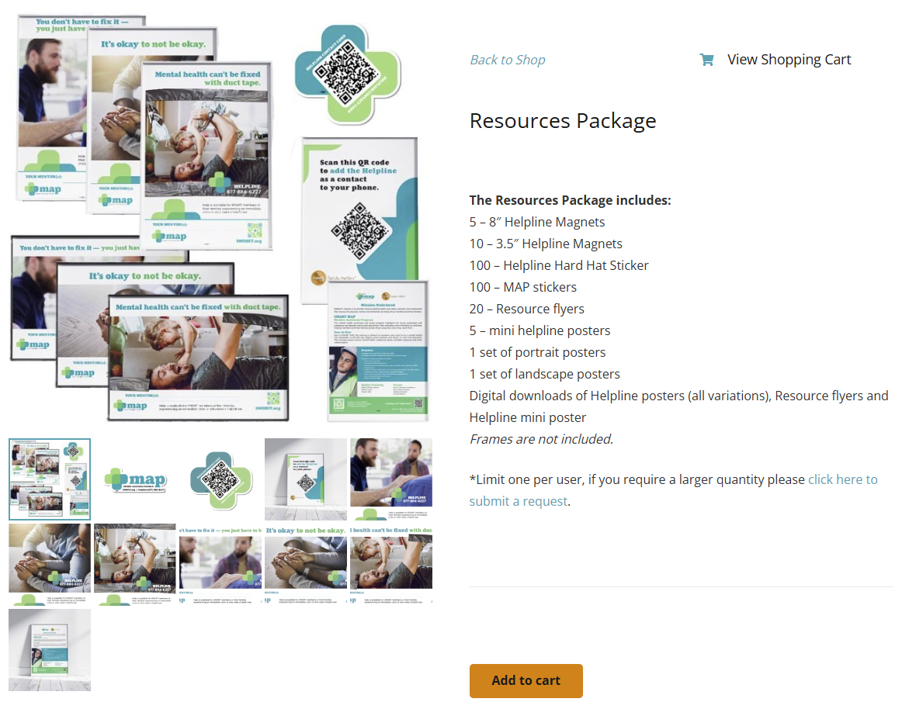
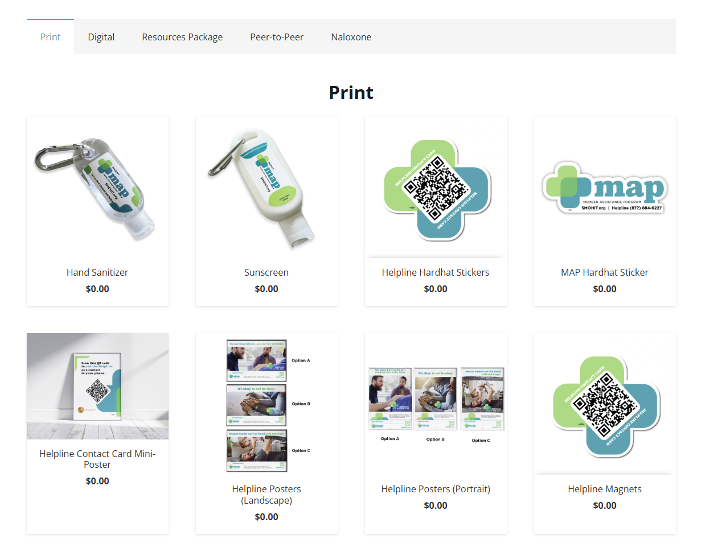
SMOHIT Store
Notes:
On the SMOHIT store, you can order physical items or download digital versions at no charge. SMOHIT covers the cost of the items and the shipping. There is a premade Resources Package that we can send to your local that has magnets, hardhat stickers, and posters to spread the word about all the resources available to the member.

Slide 10
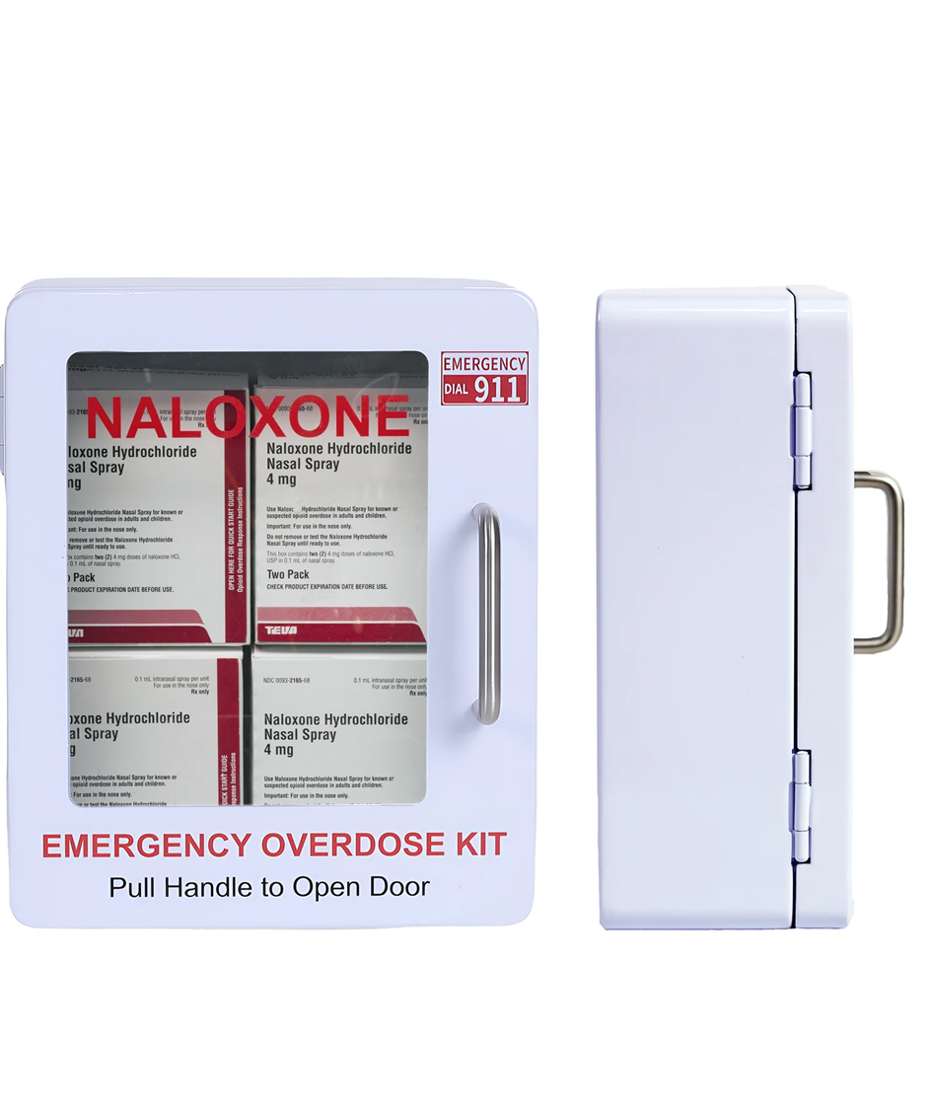
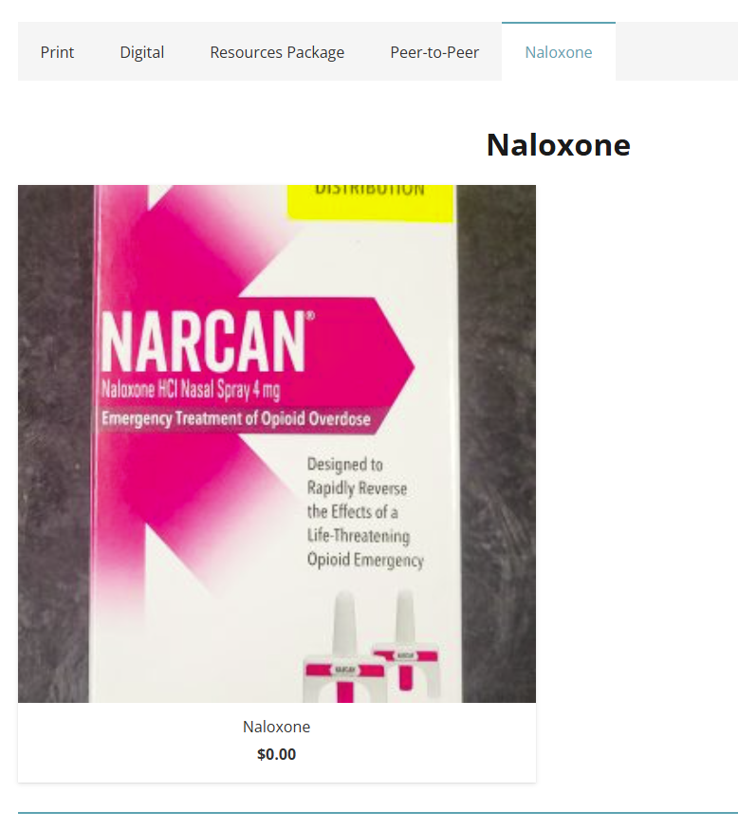
Naloxone
Emergency Treatment of Opioid Overdose
Notes:
You can also order the life-saving medication Naloxone from the store. There will be a short video and an acknowledgement that you understand how to use it the first time that you order Naloxone. After that, you won’t need to watch the video again, unless something changes in the administration process.
Your Hall and JATC’s are eligible for a Naloxone cabinet and four packages of Naloxone at no charge. If you get Naloxone from your state, we can send you the cabinet only that you can mount next to your first aid and AED cabinets.

Slide 11
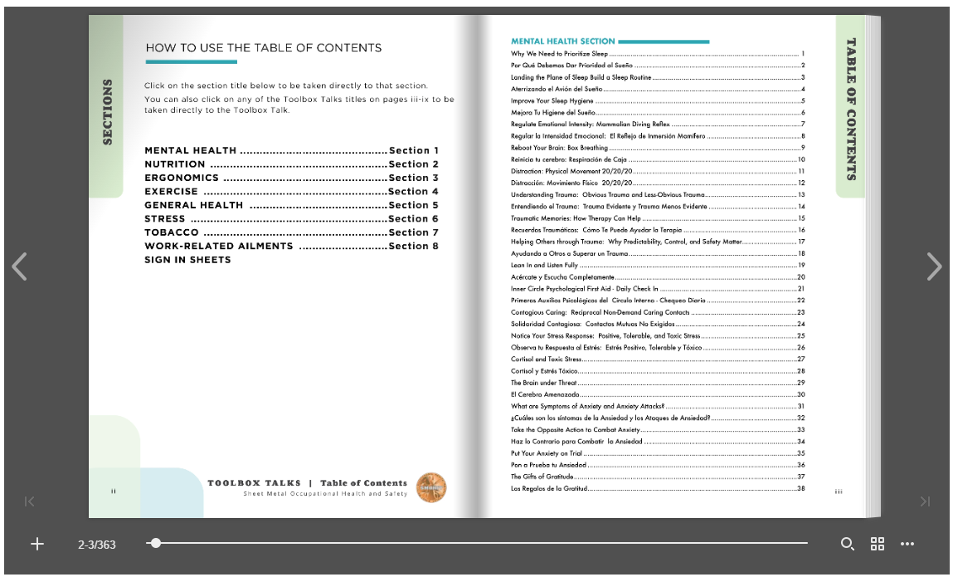
Toolbox Talks
Available in English and Spanish
Flipbook
Eight Sections
  Mental Health
  Nutrition
  Ergonomics
  Exercise
  General health
  Stress
  Tobacco
  Work-Related Ailments
Notes:
Other notes.
Keyword search. Ex. Type in sleep and you will see every instance sleep is listed in the document.

Slide 12
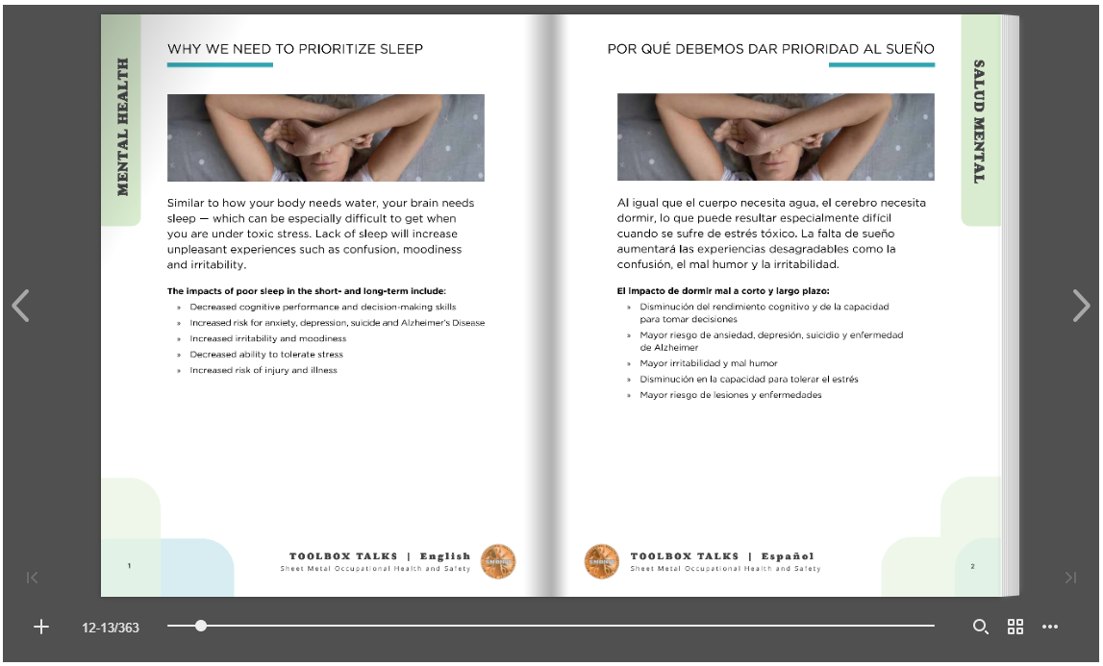
Toolbox Talks
170 Toolbox Talks
Downloadable
Printable
Sortable Table of Contents
Sign-in Sheets

Slide 13

Workplace Exposure Research Program
Formally known as the asbestos screening
Now includes silica screening
Eligibility
  SMART member with at least 10 years
  Building trades member or a sign hanger
  Member in good standing
  Eligible every 5 years

Slide 14

Workplace Exposure Research Program
When your local is eligible, SMOHIT will contact the Business Manager and schedule a date
SMOHIT will send a mailing out to eligible members approximately four weeks before the date of the x-ray at your local
Mailing will give the member directions on how to register

Slide 15
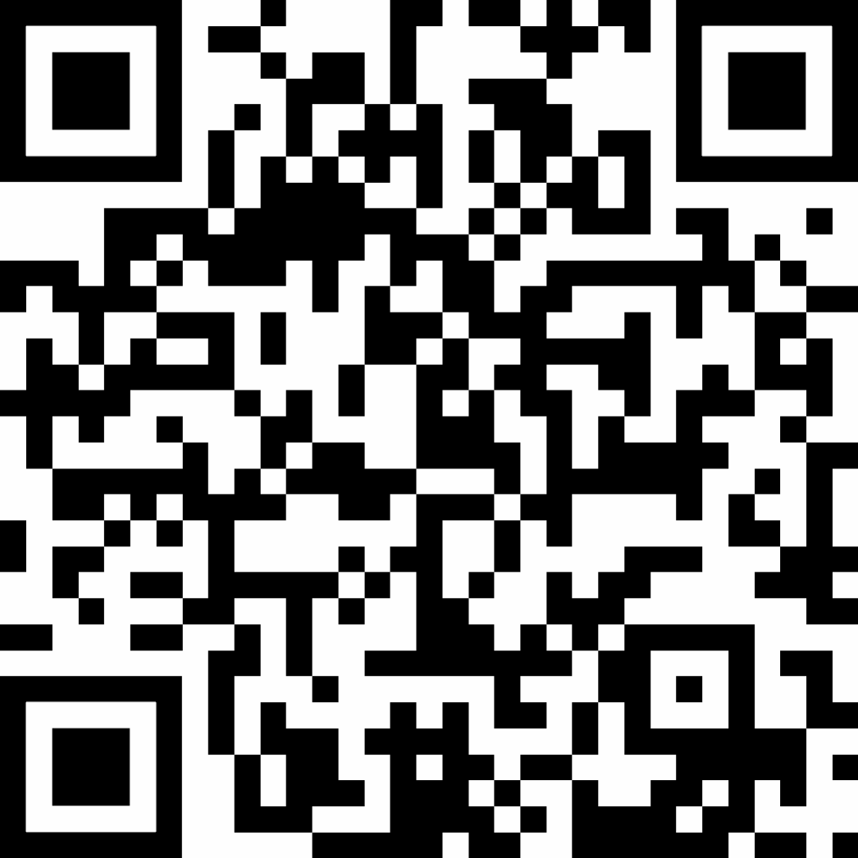
Helpline
The SMOHIT Helpline is a unique and personalized mental health service for our members and their families, operated by a variety of mental health professionals.
Grief, trauma and loss
Alcohol and other drug issues
Depression and suicidal thoughts, post-traumatic stress disorder (PTSD)
Stress related to debt
877-884-6227

Slide 16



Sheet Metal Institutes Conference
Combined Funds conference for ITI, NEMI and SMOHIT
September 22 - 24, 2026

Slide 17
Sheet Metal Institutes Conference
Combined Funds conference for ITI, NEMI and SMOHIT
September 22 - 24, 2026

Slide 18
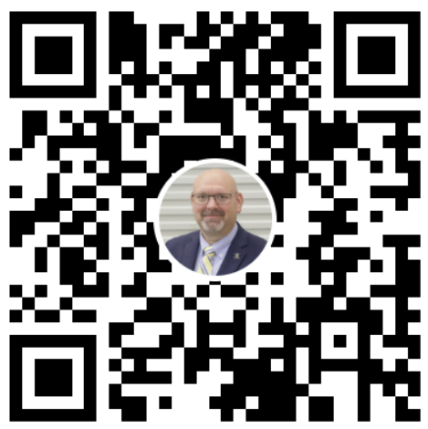
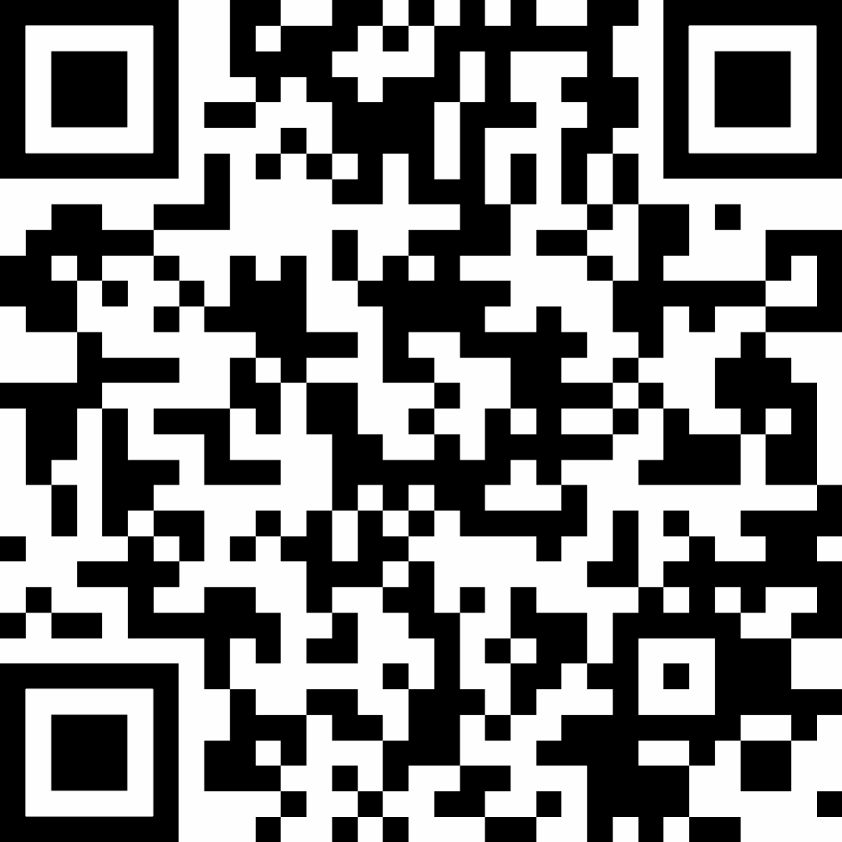
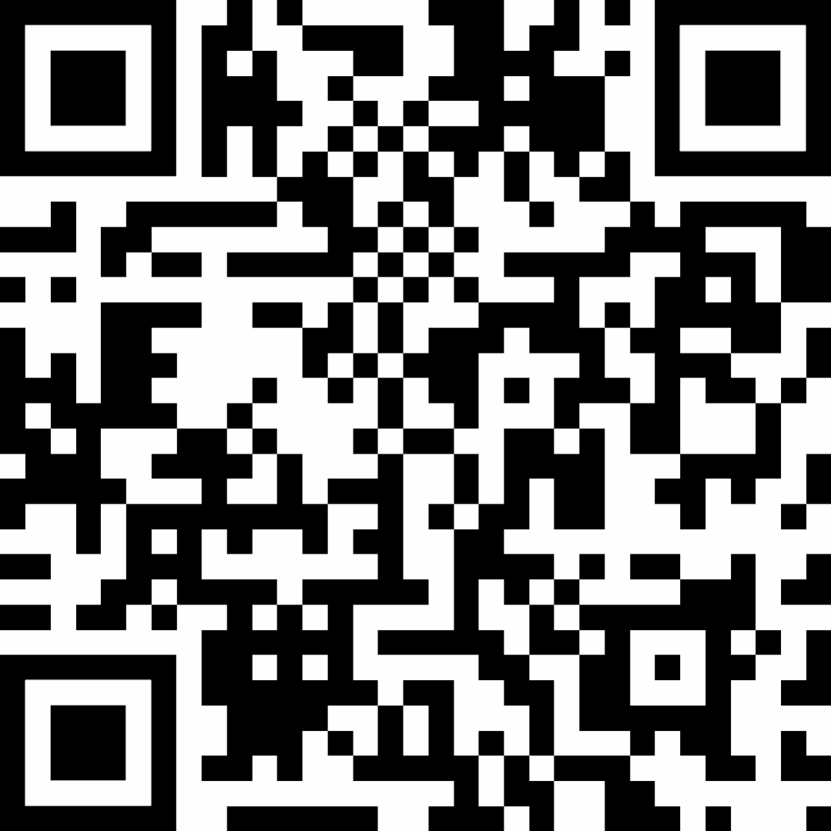
Contact
Mike Harris
Executive Director
Aldo Zambetti
Administrator
Jeff Bradley
Program Administrator

Slide 19

Social Media Accounts

